Slide 1
A Modification of Fletcher’s Algorithm
BY
Abhilash Sanap
Ritwick Mishra

Slide 2
Fletcher’s Checksum
Invented by J. G. Fletcher at Livermore Labs.
Error correction with at a fraction of computational cost.
Very easily implemented by software.
The check field in Fletcher’s algorithm is made of two 8 bit check values, placed at the end of data unit.

Slide 3
Pseudo-code of Fletcher’s checksum
integer i, sum1, sum2;
sum1 = 0;
sum2 = 0;
for i from 1 to message_length
do
sum1 = ( sum1 + message[i] ) modulo 255;
sum2 = ( sum2 + sum1 ) modulo 255;
end for
//we need to append the check quartets to the data stream.

Slide 4
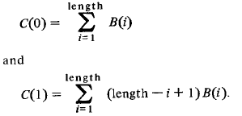
Let B(0), B(2), B(3), … , B(length) where length is the number of octets in the data unit, then after running Fletcher’s algorithm, we get

Slide 5
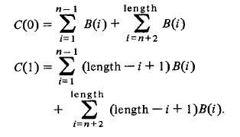
Assume we wish to use the n-th and (n+1)-st octets for our check octets. With zero in n-th and (n+1)-st octet, we have

Slide 6
B(1)+B(2)+B(3)+…+B(n-1)+X+Y+B(n+1)+…+B(length)=0 (mod M)
Length*B(1)+ (Length-1)*B(2) +….+ (Length-n+2)*B(n-1) + (Length-n+1)*X+
(Length-n)* Y + (Length-n-1)*B(n+1) +….+ B(Length)= 0 (mod M)

Slide 7
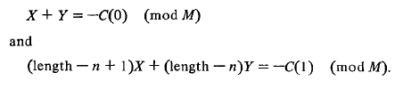
Let X and Y be the values we want in the nth and (n+1)-st octet.

Slide 8
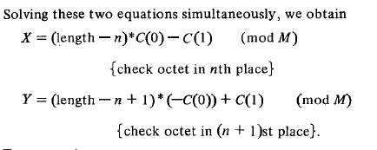

Slide 9
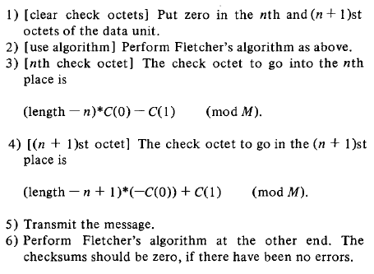

Slide 10
New features of the modified Fletcher’s Algorithm
With the modification, we can insert the check quartets anywhere in the data unit.
Now only the sender needs to know the position of the check bits.
No changes are needed in the receiver’s algorithm.
The sender can now include the check bits in the header segment of the data stream.
This modification removes the restriction of appending the check bits only at the end.
Thus, when the data unit arrives, it can be processed without having to figure out which octets contain the check information. This situation occurs when the check octets are in a variable location in the header of a data unit. In this case, the location of the check octets is indicated by part of the header which can be in error itself.

Slide 11
Application
Thus, when the data unit arrives, it can be processed without having to figure out which octets contain the check information.
This situation occurs when the check octets are in a variable location in the header of a data unit.
In this case, the location of the check octets is indicated by part of the header which can be in error itself.
Additionally, using this method rather than a simple permutation of the data unit octets, the minimum separation of undetected double bit errors (2040) is preserved.

Slide 12
Thank you

